Slide 1
Message Authentication & MAC
In the context of communication across the network, following attacks can be identified.
Disclosure
Traffic Analysis
Masquerade
Content Modification
Sequence Modification
Timing Modification
Source Repudiation
Destination Repudiation

Slide 2
Authentication Requirements
Measures to deal 1 & 2 attacks comes under message privacy.
Measures to deal with 3 to 6 comes under message authentication.
Measures to deal with 7 comes under digital signature. However, may also be used to address attacks from 3 to 6.
Measures to deal with 8 requires digital signature along with few other protocols.

Slide 3
Authentication Functions
Any message authentication is fundamentally having two levels.
At the lower level, some authenticator is generated & at the next level, generated authenticator is used to authenticate the message.
Three types of functions that may be used to produce the authenticator.
Message encryption: Ciphertext of the entire message serves as authenticator.
Message authentication Code (MAC) : Function of the message and a secret key that produces a fixed length value that serves as authenticator.
Hash function: Function that maps a message to fixed length value that serves as authenticator.

Slide 4
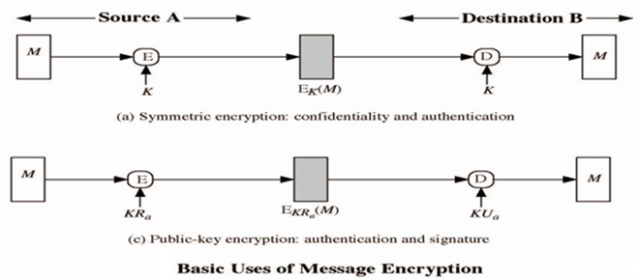
Message Encryption

Slide 5
Message Authentication Code (MAC)
Here MAC function C creates a small fixed-sized block depending on both message M and a shared secret key K.
  MAC is appended to the message M
    MAC=C_{K}(M)
    M: Message
    K: Secret key
    C: MAC function
    MAC: Message authentication code

Slide 6
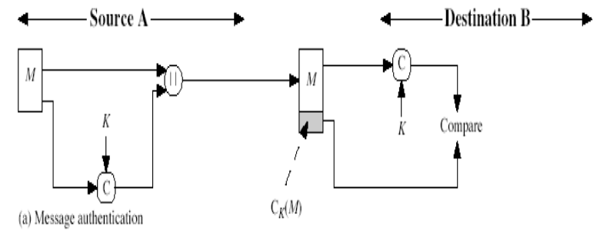
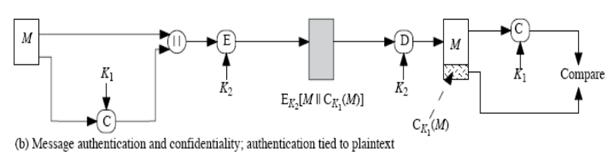
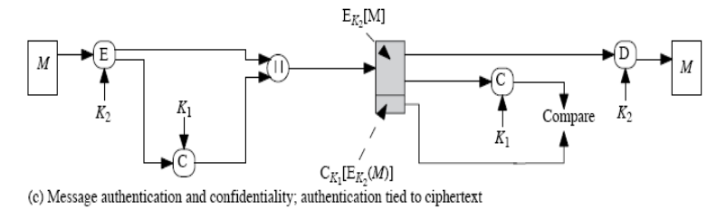
Message Authentication Code (MAC)

Slide 7
MAC function Analysis
Cryptanalysis can be done as follows:
Suppose k>n where k is the key size and n is the MAC size.
Given a known M₁ and MAC₁ with MAC₁=C_{K1}(M₁).
The cryptanalysis can perform MAC_{i}=C_{Ki}(M₁) for all possible key values.
At least one key is guaranteed to produce a match of MAC_{i}=MAC_{1.}
As there are total of 2^{n} MAC with 2^{n}<2^{k} keys i.e. a number of keys will produce the correct MAC.
On an average, 2^{k}/2^{n}=2^{k-n} keys will produce a match.

Slide 8
Requirements of MAC function
The MAC function must satisfy the following requirements:
If an opponent observes M & C_{k}(M), it is computationally infeasible for the opponent to construct the message M’ such that C_{k}(M’)=C_{k}(M).
C_{k}(M) should be uniformly distributed such that with randomly chosen messages M and M’, the probability C_{k}(M)=C_{k}(M’) is 2^{-n} where n is the number of bits in the MAC.

Slide 9
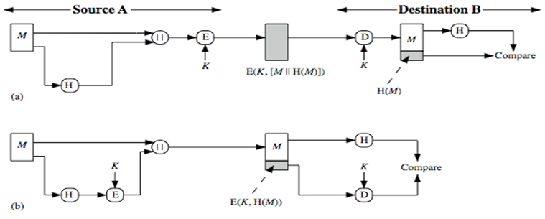
Hash Functions
A variation of the MAC is a one way hash function.
Here hash function accepts a variable size message M as input and produces a fixed size output, referred to as H(M).
(a) Encrypt message plus hash code.
(b) Encrypt hash code - shared secret key

Slide 10
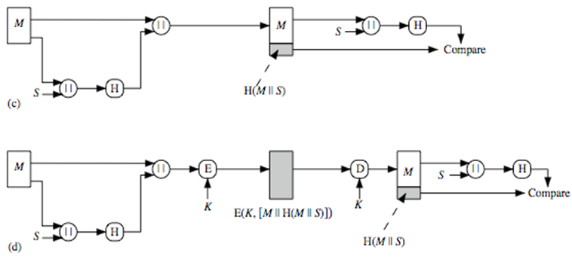
Hash Functions
(c) Compute hash code of message plus secret value.
(d) Encrypt result of (c).

Slide 11
Requirements of Hash function
H can be applied to block of data of any size.
H produces fixed-length output.
H(x) is relatively easy to compute for any given x.
For any given h, it is computationally infeasible to find x such that H(x)=h. This is referred to as one-way property.
For any given block x, it is computationally infeasible to find y≠x with H(y)=H(x). This is referred to as weak collision resistance.
It is computationally infeasible to find pair (x,y) such that H(x)=H(y). This is referred to as strong collision resistance.

Slide 12
Security of Hash Function & MACs
We can group attacks on hash function and MAC’s into two categories: brute force attacks and cryptanalysis.
Brute force attack:
Hash functions:
For any given h, it is computationally infeasible to find x such that H(x)=h. This is referred to as one-way property.
For any given block x, it is computationally infeasible to find y≠x with H(y)=H(x). This is referred to as weak collision resistance.
It is computationally infeasible to find pair (x,y) such that H(x)=H(y). This is referred to as strong collision resistance.

Slide 13
Security of Hash Function & MACs
For a code of length n, the level of effort required is proportional to the following:
    One way: 2^{n}
    Weak collision resistance: 2^{n}
    Strong Collision resistance: 2^{n/2}

Slide 14
Security of Hash Function & MACs
Brute force attack:
MAC:
Given a fixed message x with n-bit MAC code h=H(x), a brute force method of finding a collision is to pick a random bit string and check if H(y)=H(x).
There are two lines of attacks possible: Attack the key space and attack the MAC values.
Attack on Key space:
Suppose the key size is k bits and that the attacker has one known text MAC pair. Then the attacker can compute the n-bit MAC on the known text for all possible keys.
At least, one key is guaranteed to produce the correct match.
This phase of attack takes a level of effort proportional to 2^{k}

Slide 15
Security of Hash Function & MACs
Attack on MAC space:
The objective is to generate a valid MAC value for a given message or to find a message that matches a given MAC value.
The level of effort is comparable to that for attacking the one way or weak collision resistance property of a hash function (2^{n}).
Finally the level of effort for brute force attack on a MAC algorithm can be expressed as min(2^{k},2^{n} ).

Slide 16
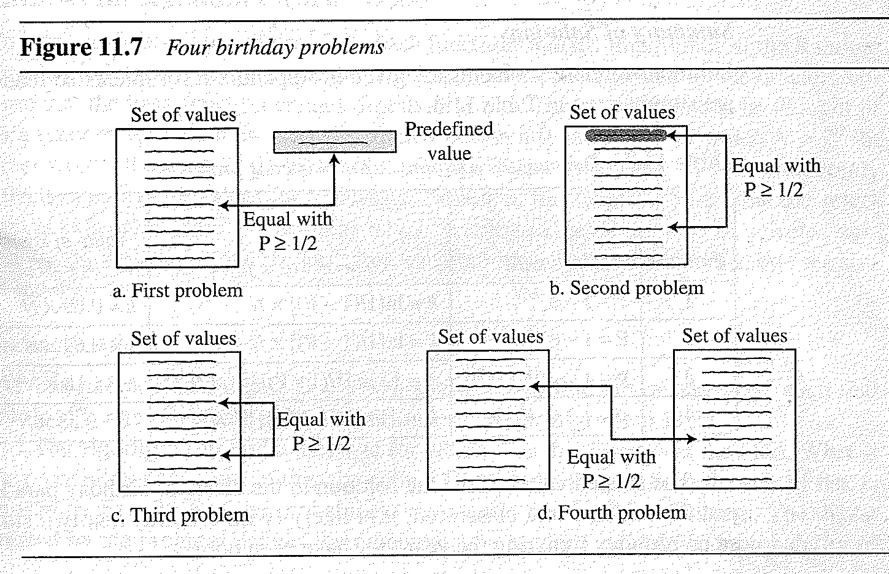
Birthday Problems
The four different birthday problems usually there in probability.
The third problem is refereed to as Birthday paradox.

Slide 17
Birthday Problems
Problem 1: What is the minimum number, k, of students in classroom such that it is likely that at least one student has a predefined birthday.
We have a uniformly distributed random variable with N possible values, then what is the minimum number of instances k such that it is likely that at least one instance is equal to a predefined value.
Problem 2: What is the minimum number, k, of students in classroom such that it is likely that at least one student has the same birthday as the student selected by the professor.
We have a uniformly distributed random variable with N possible values, then what is the minimum number of instances k such that it is likely that at least one instance is equal to the selected one.

Slide 18
Birthday Problems
Problem 3: What is the minimum number, k, of students in classroom such that it is likely that at least two students have the same birthday.
We have a uniformly distributed random variable with N possible values, then what is the minimum number of instances k such that it is likely that at least two instances are equal.
Problem 4: We have two classes, each with k students. What is the minimum value k so that it is likely that at least one student from the first classroom has the same birthday as a student from the second classroom
We have a uniformly distributed random variable with N possible values. We generate two sets of random values each with k instances. What is the minimum number k such that it is likely that at least one instance from the first set is equal to one instance on the second set.

Slide 19
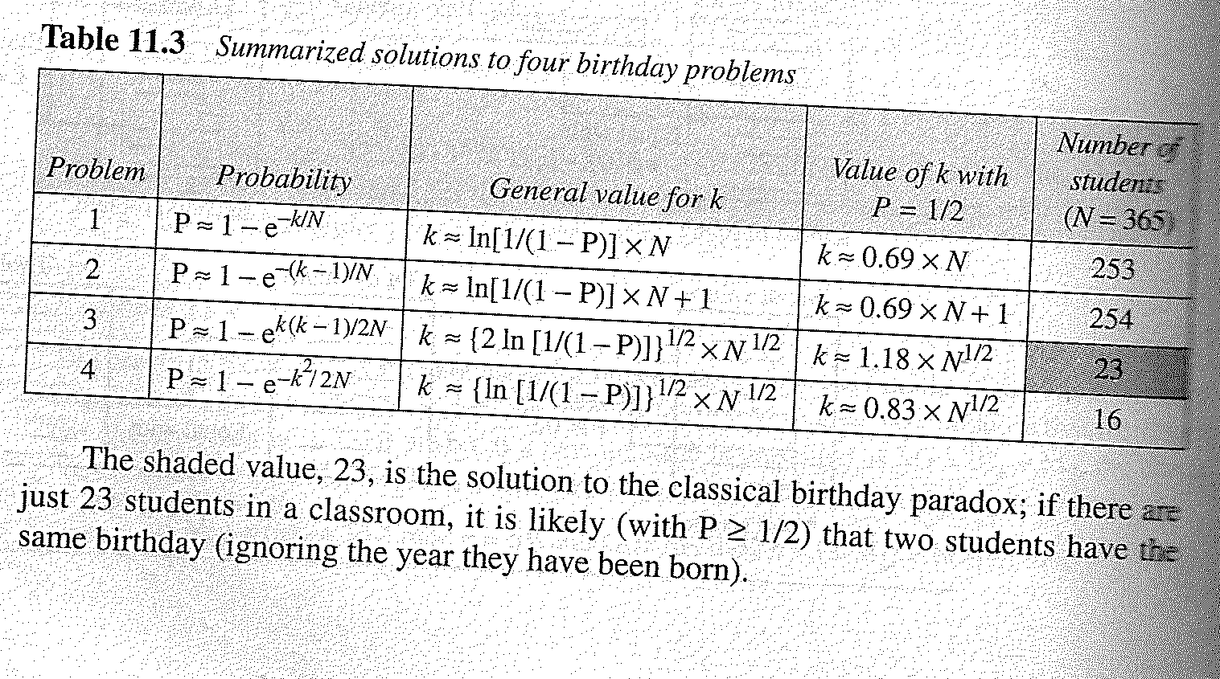
Birthday Problems
23 is the solution to the classical Birthday paradox problem. If there are just 23 students in a classroom, it is likely that (with P >1/2) that the two students have the same birthday (ignoring the year of birth).

Slide 20

SHA Versions
Notes:
Stallings Table 11.3 provides a comparison of the various parameters for the SHA hash functions.

Slide 21
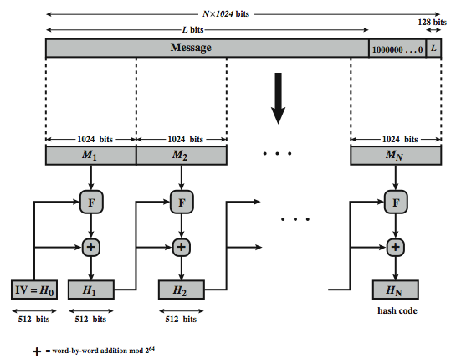
SHA-512 Overview
Notes:
Now examine the structure of SHA-512, noting that the other versions are quite similar.
SHA-512 follows the structure depicted in Stallings Figure 11.8. The processing consists of the following steps:
• Step 1: Append padding bits, consists of a single 1-bit followed by the necessary number of 0-bits, so that its length is congruent to 896 modulo 1024
• Step 2: Append length as an (big-endian) unsigned 128-bit integer
• Step 3: Initialize hash buffer to a set of 64-bit integer constants (see text)
• Step 4: Process the message in 1024-bit (128-word) blocks, which forms the heart of the algorithm. Each round takes as input the 512-bit buffer value H_{i}, and updates the contents of that buffer.
• Step 5: Output the final state value as the resulting hash
See text for more details.

Slide 22
SHA-512 Logic
1. Append padding bits : The message is padded, so that padded message is 128 bits less than an integer multiple of 1024.
2. Append length: A 128 bits of message length is appended to the message. (M mod 2^128)
3. Initialize hash buffer: A 512 bit buffer is used to hold intermediate and final results.
a=6A09E667F3BCC908, b=, c=, d=, e=,f=,g=, h=
These values are stored in big-endian format.
Notes:
The SHA-512 Compression Function is the heart of the algorithm. In this Step 4, it processes the message in 1024-bit (128-word) blocks, using a module that consists of 80 rounds, labeled F in Stallings Figure 11.8, and is shown in detail in Figure 11.9. Each round takes as input the 512-bit buffer value, and updates the contents of the buffer. At input to the first round, the buffer has the value of the intermediate hash value. Each round t makes use of a 64-bit value Wt derived using a message schedule from the current 1024-bit block being processed. Each round also makes use of an additive constant Kt, based on the fractional parts of the cube roots of the first eighty prime numbers. The constants provide a “randomized” set of 64-bit patterns, which should eliminate any regularities in the input data. The output of the eightieth round is added to the input to the first round to produce the final hash value for this message block, which forms the input to the next iteration of this compression function, as shown on the previous slide.

Slide 23
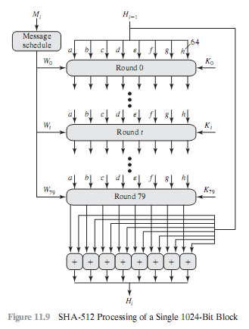
4. Processing in multiple of 1024-bit blocks: This module is the heart of the algorithm and consists of 80 rounds.

Slide 24
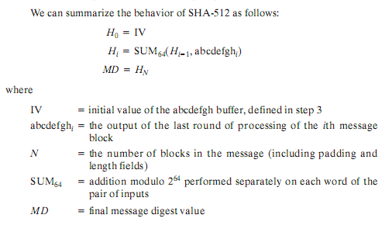
4. SHA Processing
5. Output: After all N 1024 bit blocks have been processed, the output from the Nth stage is the 512 bit digest.
Notes:
The SHA-512 Compression Function is the heart of the algorithm. In this Step 4, it processes the message in 1024-bit (128-word) blocks, using a module that consists of 80 rounds, labeled F in Stallings Figure 11.8, and is shown in detail in Figure 11.9. Each round takes as input the 512-bit buffer value, and updates the contents of the buffer. At input to the first round, the buffer has the value of the intermediate hash value. Each round t makes use of a 64-bit value Wt derived using a message schedule from the current 1024-bit block being processed. Each round also makes use of an additive constant Kt, based on the fractional parts of the cube roots of the first eighty prime numbers. The constants provide a “randomized” set of 64-bit patterns, which should eliminate any regularities in the input data. The output of the eightieth round is added to the input to the first round to produce the final hash value for this message block, which forms the input to the next iteration of this compression function, as shown on the previous slide.

Slide 25
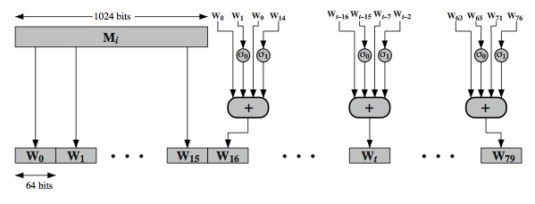
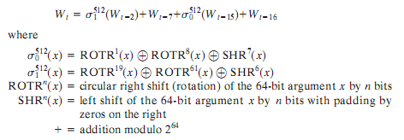
SHA-512 Round Function Wn
Notes:
Stallings Figure 11.11 illustrates how the 64-bit word values Wt are derived from the 1024-bit message. The first 16 values of Wt are taken directly from the 16 words of the current block. The remaining values are defined as a function of the earlier values using ROTates, SHIFTs and XORs as shown. The function elements are:
∂0(x) = ROTR(x,1) XOR ROTR(x,8) XOR SHR(x,7)
∂1(x) = ROTR(x,19) XOR ROTR(x,61) XOR SHR(x,6)
Thus, in the first 16 steps of processing, the value of W_{t} is equal to the corresponding word in the message block. For the remaining 64 steps, the value of W_{t} consists of the circular left shift by one bit of the XOR of four of the preceding values of W_{t}, with two of those values subjected to shift and rotate operations. This introduces a great deal of redundancy and interdependence into the message blocks that are compressed, which complicates the task of finding a different message block that maps to the same compression function output.
See text for details of an example based on one in FIPS 180.

Slide 26
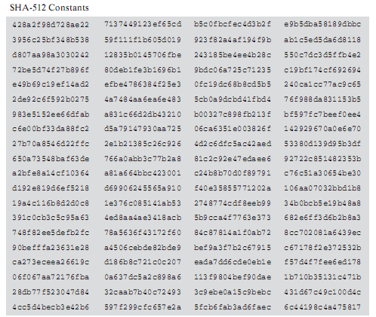
SHA-512 Round Function Kt
Each round makes use of additive constant Kt where each Kt represents fractional parts of the cube roots the first 80 prime numbers.
Notes:
Stallings Figure 11.11 illustrates how the 64-bit word values Wt are derived from the 1024-bit message. The first 16 values of Wt are taken directly from the 16 words of the current block. The remaining values are defined as a function of the earlier values using ROTates, SHIFTs and XORs as shown. The function elements are:
∂0(x) = ROTR(x,1) XOR ROTR(x,8) XOR SHR(x,7)
∂1(x) = ROTR(x,19) XOR ROTR(x,61) XOR SHR(x,6)
Thus, in the first 16 steps of processing, the value of W_{t} is equal to the corresponding word in the message block. For the remaining 64 steps, the value of W_{t} consists of the circular left shift by one bit of the XOR of four of the preceding values of W_{t}, with two of those values subjected to shift and rotate operations. This introduces a great deal of redundancy and interdependence into the message blocks that are compressed, which complicates the task of finding a different message block that maps to the same compression function output.
See text for details of an example based on one in FIPS 180.

Slide 27
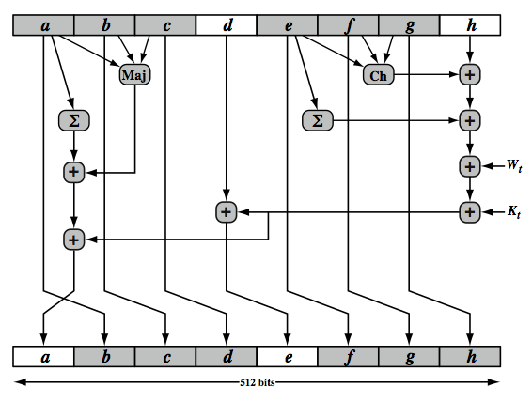
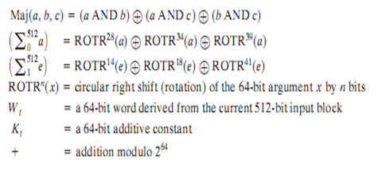
SHA-512 Round Function
Notes:
The structure of each of the 80 rounds is shown in Stallings Figure 11.10. Each 64-bit word is shuffled along one place, and in some cases manipulated using a series of simple logical functions (ANDs, NOTs, ORs, XORs, ROTates), in order to provide the avalanche & completeness properties of the hash function. The elements are:
Ch(e,f,g) = (e AND f) XOR (NOT e AND g)
Maj(a,b,c) = (a AND b) XOR (a AND c) XOR (b AND c)
∑(a) = ROTR(a,28) XOR ROTR(a,34) XOR ROTR(a,39)
∑(e) = ROTR(e,14) XOR ROTR(e,18) XOR ROTR(e,41)
+ = addition modulo 2^64
Kt = a 64-bit additive constant
Wt = a 64-bit word derived from the current 512-bit input block.
Six of the eight words of the output of the round function involve simply permutation (b, c, d, f, g, h) by means of rotation. This is indicated by shading in Figure 11.10. Only two of the output words (a, e) are generated by substitution. Word e is a function of input variables d, e, f, g, h, as well as the round word W t and the constant Kt. Word a is a function of all of the input variables, as well as the round word W t and the constant Kt.

Slide 28

Chapter 13
Digital Signature
Copyright © The McGraw-Hill Companies, Inc. Permission required for reproduction or display.
13.<number>

Slide 29
13-1 COMPARISON
Let us begin by looking at the differences between conventional signatures and digital signatures.
Topics to be discussed :
13.1.1 Inclusion
13.1.2 Verification Method
13.1.3 Relationship
13.1.4 Duplicity
13.<number>

Slide 30
13.1.1 Inclusion
A conventional signature is included in the document; it is part of the document.
But when we sign a document digitally, we send the signature as a separate document.
13.<number>

Slide 31
13.1.2 Verification Method
For a conventional signature, when the recipient receives a document, she compares the signature on the document with the signature on file.
For a digital signature, the recipient receives the message and the signature. The recipient needs to apply a verification technique to the combination of the message and the signature to verify the authenticity.
13.<number>

Slide 32
13.1.3 Relationship
For a conventional signature, there is normally a one-to-many relationship between a signature and documents.
For a digital signature, there is a one-to-one relationship between a signature and a message.
13.<number>

Slide 33
13.1.4 Duplicity
In conventional signature, a copy of the signed document can be distinguished from the original one on file.
In digital signature, there is no such distinction unless there is a factor of time on the document.
13.<number>

Slide 34
13-2 PROCESS
Figure shows the digital signature process.
The sender uses a signing algorithm to sign the message.
The message and the signature are sent to the receiver.
The receiver receives the message and the signature and applies the verifying algorithm to the combination.
If the result is true, the message is accepted; otherwise, it is rejected.
13.<number>

Slide 35
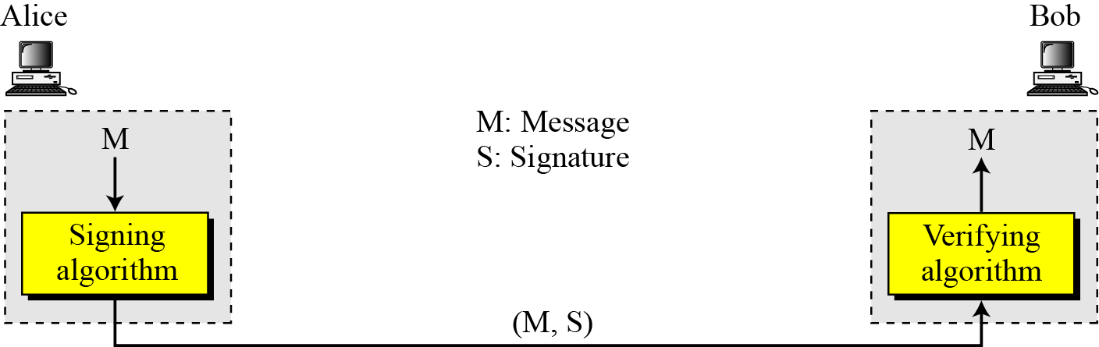
13-2 Continued
Digital signature process
13.<number>

Slide 36
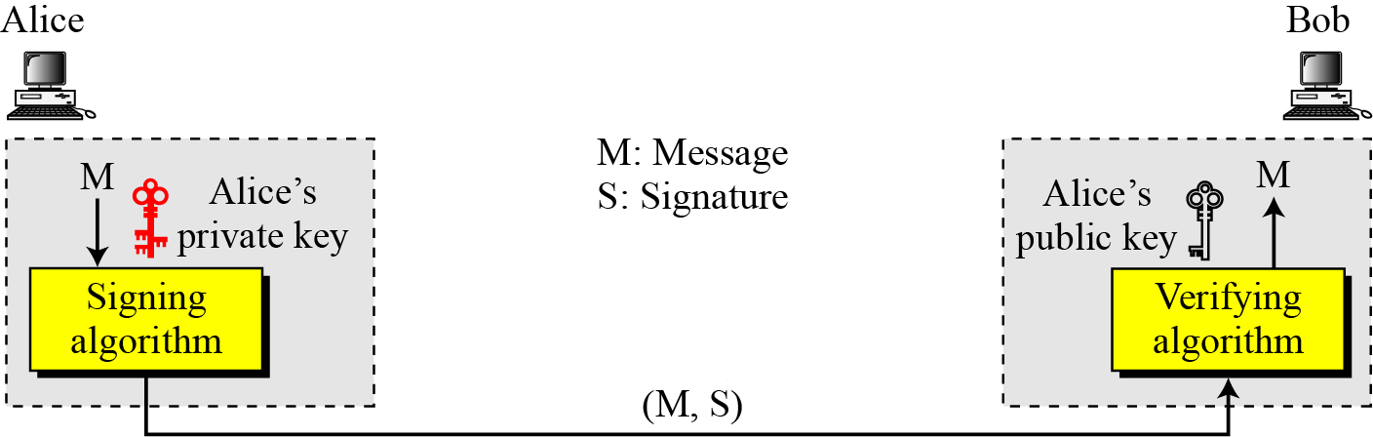

13.2.1 Need for Keys
Adding key to the digital signature process
Note
A digital signature needs a public-key system.
The signer signs with her private key; the verifier verifies with the signer’s public key.
13.<number>

Slide 37
13.2.1 Continued
Note
A cryptosystem uses the private and public keys of the receiver: a digital signature uses
the private and public keys of the sender.
13.<number>

Slide 38
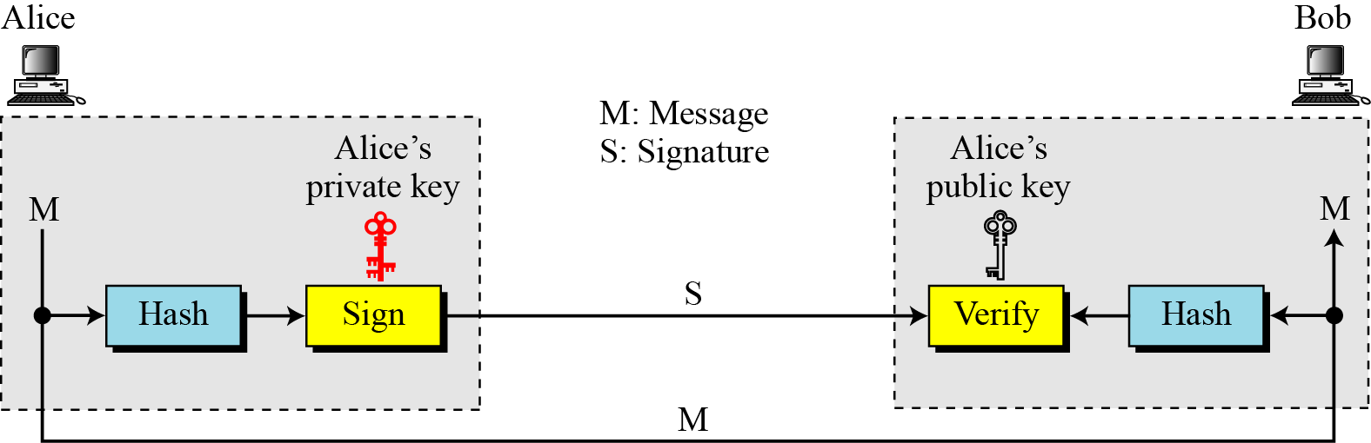
13.2.2 Signing the Digest
Signing the digest
13.<number>

Slide 39
13-3 SERVICES
We discussed several security services earlier including message confidentiality, message authentication, message integrity, and nonrepudiation.
A digital signature can directly provide the last three; for message confidentiality we still need encryption/decryption.
13.<number>

Slide 40
13.3.1 Message Authentication
A secure digital signature scheme, like a secure conventional signature can provide message authentication. Bob can verify that the message is sent by Alice because Alice’s public key is used in verification.
Note
A digital signature provides message authentication.
13.<number>

Slide 41
13.3.2 Message Integrity
The integrity of the message is preserved even if we sign the whole message because we cannot get the same signature if the message is changed.
Note
A digital signature provides message integrity.
13.<number>

Slide 42
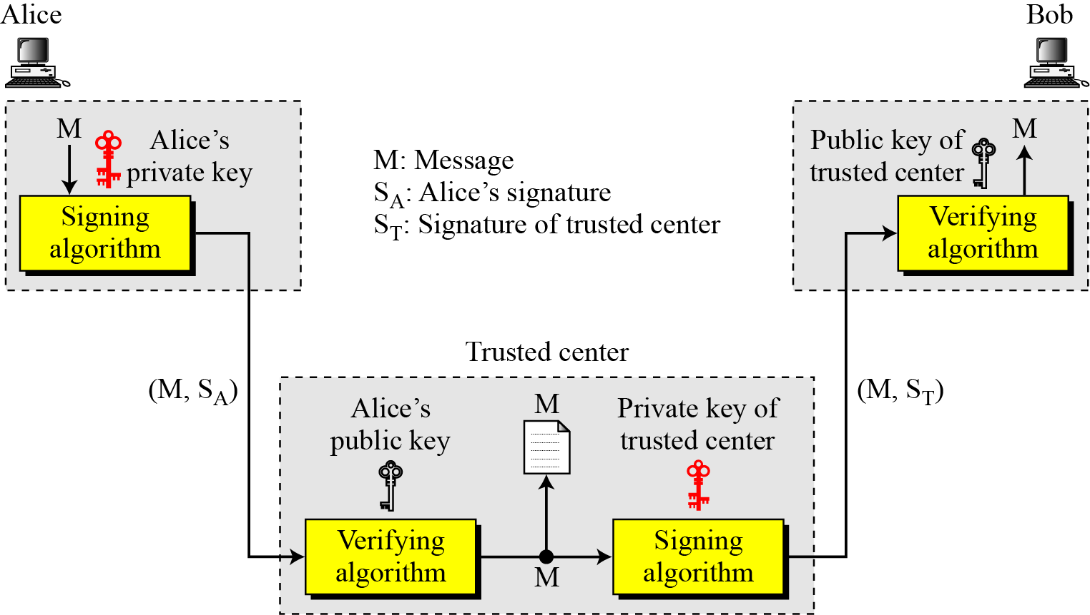
13.3.3 Nonrepudiation
Figure 13.4 Using a trusted center for nonrepudiation
Note
Nonrepudiation can be provided using a trusted party.
13.<number>

Slide 43
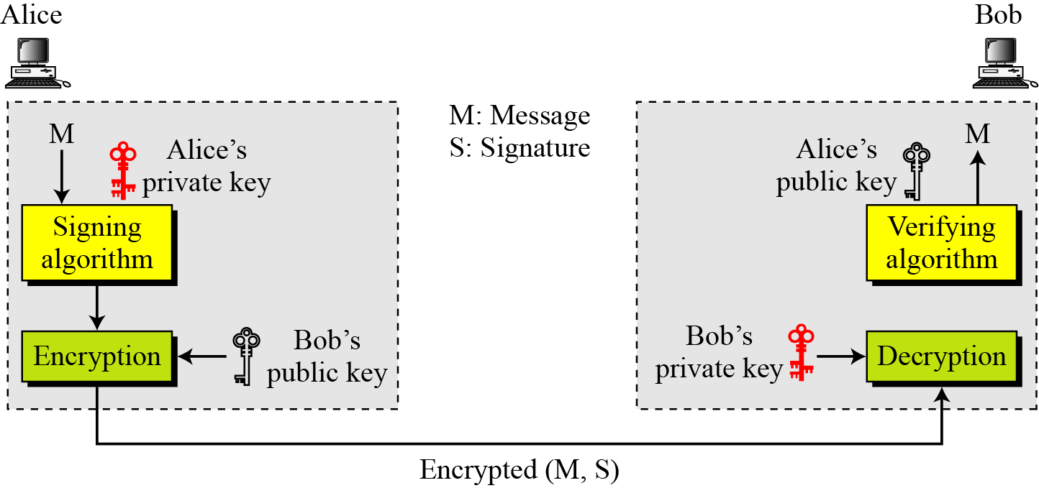
13.3.4 Confidentiality
Figure 13.5 Adding confidentiality to a digital signature scheme
Note
A digital signature does not provide privacy.
If there is a need for privacy, another layer of encryption/decryption must be applied.
13.<number>

Slide 44
DIGITAL SIGNATURE SCHEMES
Several digital signature schemes have evolved during the last few decades. Some of them have been implemented.
RSA Digital Signature Scheme
ElGamal Digital Signature Scheme
Digital Signature Standard (DSS)
13.<number>

Slide 45
13.5.1 Continued
Key Generation
Key generation in the RSA digital signature scheme is exactly the same as key generation in the RSA
Note
In the RSA digital signature scheme, d is private;
e and n are public.
13.<number>

Slide 46
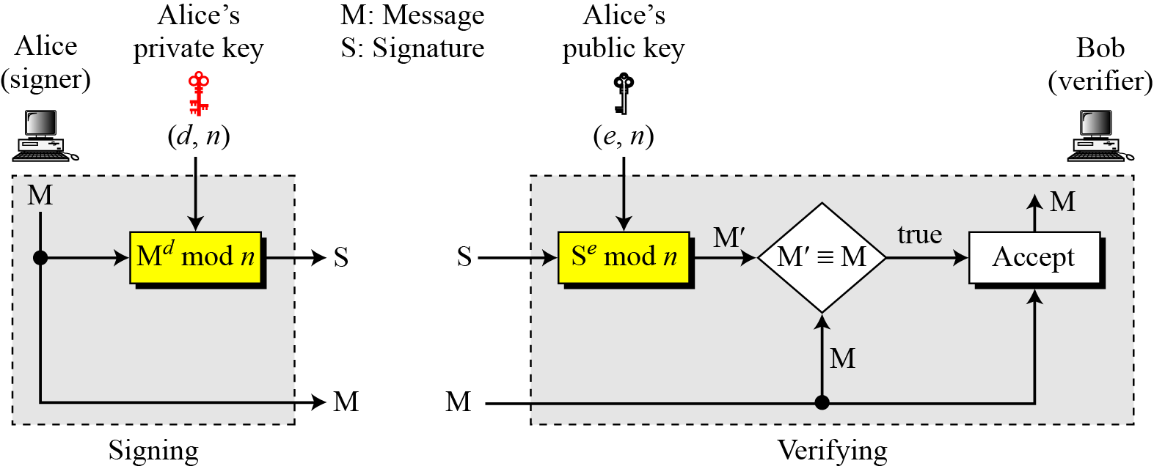
13.5.1 Continued
Signing and Verifying
Figure 13.7 RSA digital signature scheme
13.<number>

Slide 47
13.5.1 Continued
Example 13.1
As a trivial example, suppose that Alice chooses p = 823 and q = 953, and calculates n = 784319. The value of φ(n) is 782544. Now she chooses e = 313 and calculates d = 160009. At this point key generation is complete. Now imagine that Alice wants to send a message with the value of M = 19070 to Bob. She uses her private exponent, 160009, to sign the message:
Alice sends the message and the signature to Bob. Bob receives the message and the signature. He calculates
Bob accepts the message because he has verified Alice’s signature.
13.<number>

Slide 48
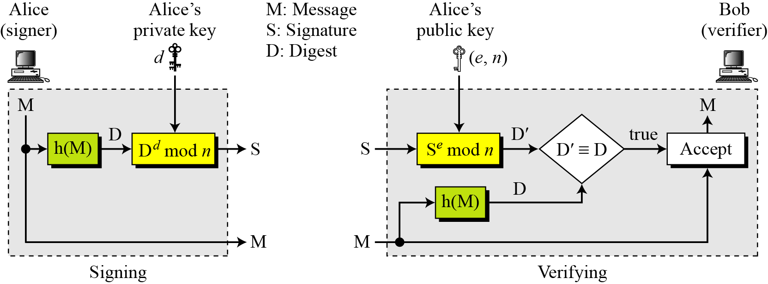
13.5.1 Continued
RSA Signature on the Message Digest
Figure 13.8 The RSA signature on the message digest
13.<number>

Slide 49
13.5.1 Continued
Note
When the digest is signed instead of the message itself, the susceptibility of the RSA digital signature scheme depends on the strength of the hash algorithm.
13.<number>

Slide 50
13.5.2 Continued
ElGamal digital signature scheme
Key Generation
The key generation procedure here is exactly the same as the one used in the cryptosystem.
Note
In ElGamal digital signature scheme, (e₁, e₂, p) is Alice’s public key; d is her private key.
13.<number>

Slide 51
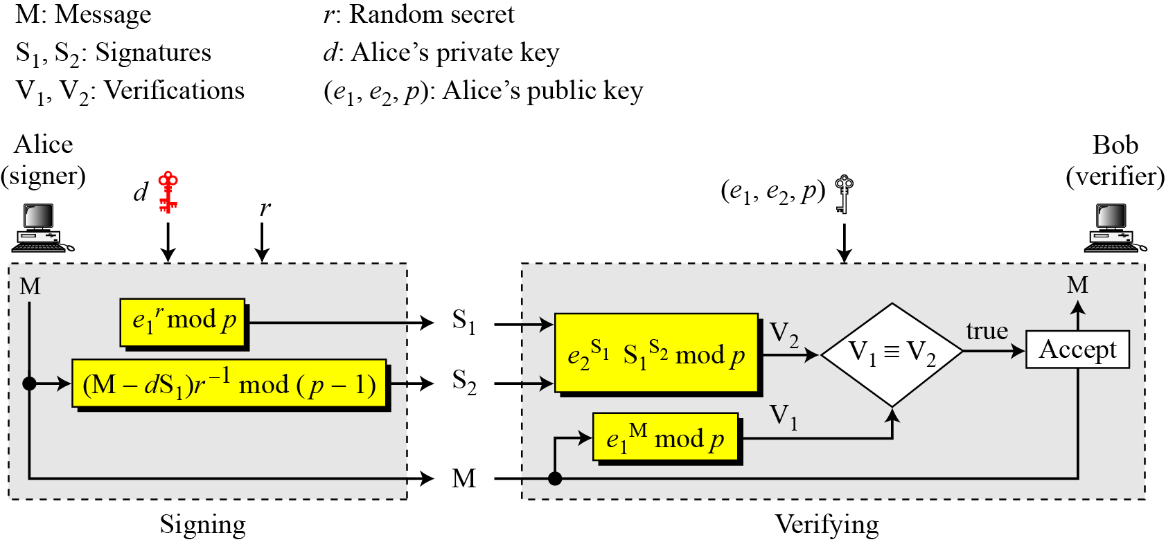
13.5.2 Continued
Verifying and Signing
Figure 13.10 ElGamal digital signature scheme
13.<number>

Slide 52
Digital Signature Standard (DSS)
US Govt approved signature scheme
designed by NIST & NSA in early 90's
published as FIPS-186 in 1991
revised in 1993, 1996 & then 2000
uses the SHA hash algorithm
DSS is the standard, DSA is the algorithm
FIPS 186-2 (2000) includes alternative RSA & elliptic curve signature variants
DSA is digital signature only unlike RSA is a public-key technique
Notes:
DSA is the US Govt approved signature scheme, which is designed to provide strong signatures without allowing easy use for encryption. The National Institute of Standards and Technology (NIST) published Federal Information Processing Standard FIPS 186, known as the Digital Signature Standard (DSS). The DSS makes use of the Secure Hash Algorithm (SHA) described in Chapter 12 and presents a new digital signature technique, the Digital Signature Algorithm (DSA). The DSS was originally proposed in 1991 and revised in 1993 in response to public feedback concerning the security of the scheme. There was a further minor revision in 1996. In 2000, an expanded version of the standard was issued as FIPS 186-2. This latest version also incorporates digital signature algorithms based on RSA and on elliptic curve cryptography. In this section, we discuss the original DSS algorithm. The DSS uses an algorithm that is designed to provide only the digital signature function. Unlike RSA, it cannot be used for encryption or key exchange. Nevertheless, it is a public-key technique.

Slide 53
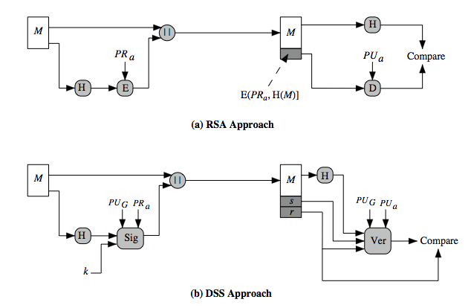
DSS vs RSA Signatures
Notes:
Stallings Figure 13.3 contrasts the DSS approach for generating digital signatures to that used with RSA. In the RSA approach, the message to be signed is input to a hash function that produces a secure hash code of fixed length. This hash code is then encrypted using the sender's private key to form the signature. Both the message and the signature are then transmitted. The recipient takes the message and produces a hash code. The recipient also decrypts the signature using the sender's public key. If the calculated hash code matches the decrypted signature, the signature is accepted as valid. Because only the sender knows the private key, only the sender could have produced a valid signature. The DSS approach also makes use of a hash function. The hash code is provided as input to a signature function along with a random number k generated for this particular signature. The signature function also depends on the sender's private key (PR _{a}) and a set of parameters known to a group of communicating principals. We can consider this set to constitute a global public key (PU_{G}). The result is a signature consisting of two components, labeled s and r. At the receiving end, the hash code of the incoming message is generated. This plus the signature is input to a verification function. The verification function also depends on the global public key as well as the sender's public key (PU_{a}), which is paired with the sender's private key. The output of the verification function is a value that is equal to the signature component r if the signature is valid. The signature function is such that only the sender, with knowledge of the private key, could have produced the valid signature.

Slide 54
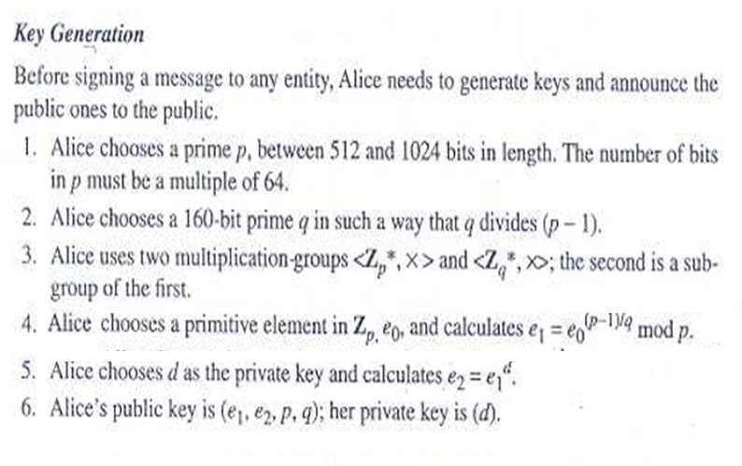
Digital Signature Standard (DSS)
Notes:
DSA is the US Govt approved signature scheme, which is designed to provide strong signatures without allowing easy use for encryption. The National Institute of Standards and Technology (NIST) published Federal Information Processing Standard FIPS 186, known as the Digital Signature Standard (DSS). The DSS makes use of the Secure Hash Algorithm (SHA) described in Chapter 12 and presents a new digital signature technique, the Digital Signature Algorithm (DSA). The DSS was originally proposed in 1991 and revised in 1993 in response to public feedback concerning the security of the scheme. There was a further minor revision in 1996. In 2000, an expanded version of the standard was issued as FIPS 186-2. This latest version also incorporates digital signature algorithms based on RSA and on elliptic curve cryptography. In this section, we discuss the original DSS algorithm. The DSS uses an algorithm that is designed to provide only the digital signature function. Unlike RSA, it cannot be used for encryption or key exchange. Nevertheless, it is a public-key technique.

Slide 55
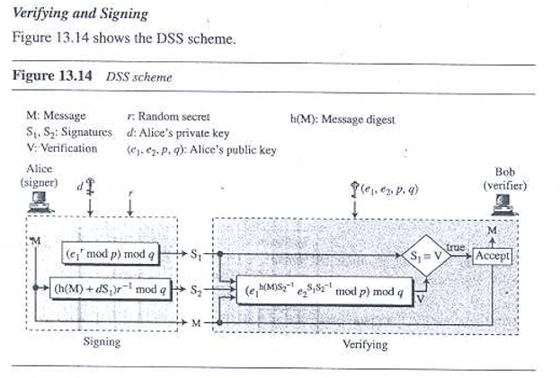
Digital Signature Standard (DSS)
13.<number>

Slide 56
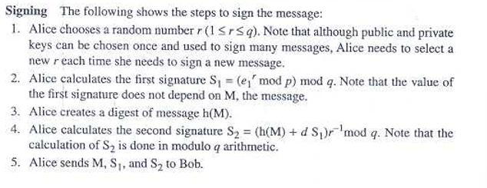
Digital Signature Standard (DSS)
13.<number>

